Slide 1
CAP476: Data Communication and Networking Unit-4: Network-Layer - Routing

Slide 2
Network Layer
The network layer is responsible for the source-to-destination delivery of a packet, possibly across multiple networks (links).
Whereas the data link layer oversees the delivery of the packet between two systems on the same network (links), the network layer ensures that each packet gets from its point of origin to its final destination.
The network layer is responsible for the delivery of individual packets from the source to the destination host.
The network layer adds a header that includes the logical addresses of the sender and receiver to the packet corning from the upper layer. If a packet travels through the Internet, we need this addressing system to help distinguish the source and destination.
When independent networks or links are connected together to create an internetwork, routers or switches route packets to their final destination. One of the functions of the network layer is to provide a routing mechanism.

Slide 3
Functions of Network Layer
Network layer is majorly focused on getting packets from the source to the destination, routing error handling and congestion control. Before learning about design issues in the network layer, let’s learn about it’s various functions.
Logical Addressing: Maintains the address at the frame header of both source and destination and performs addressing to detect various devices in network.
Packetizing: This is performed by Internet Protocol. The network layer converts the packets from its upper layer.
Routing: It is the most important functionality. The network layer chooses the most relevant and best path for the data transmission from source to destination.
Inter-networking: It works to deliver a logical connection across multiple devices.

Slide 4
Network Layer Design Issues
The network layer comes with some design issues they are described as follows:
Store and Forward packet switching: The host sends the packet to the nearest router. This packet is stored there until it has fully arrived once the link is fully processed by verifying the checksum then it is forwarded to the next router till it reaches the destination. This mechanism is called “Store and Forward packet switching.”
Services provided to Transport Layer: Through the network/transport layer interface, the network layer transfers it’s services to the transport layer. Based on the connections there are 2 types of services provided:
Connectionless – The routing and insertion of packets into subnet is done individually. No added setup is required.
Connection-Oriented – Subnet must offer reliable service and all the packets must be transmitted over a single route.

Slide 5
Implementation of Connectionless Service: Packet are termed as “datagrams” and corresponding subnet as “datagram subnets”. When the message size that has to be transmitted is 4 times the size of the packet, then the network layer divides into 4 packets and transmits each packet to router via. a few protocol. Each data packet has destination address and is routed independently irrespective of the packets.
Implementation of Connection Oriented service: To use a connection-oriented service, first we establishes a connection, use it and then release it. In connection-oriented services, the data packets are delivered to the receiver in the same order in which they have been sent by the sender. It can be done in either two ways :
Circuit Switched Connection: A dedicated physical path or a circuit is established between the communicating nodes and then data stream is transferred.
Virtual Circuit Switched Connection: The data stream is transferred over a packet switched network, in such a way that it seems to the user that there is a dedicated path from the sender to the receiver. A virtual path is established here. While, other connections may also be using the same path.

Slide 6
Routing
Routing is the act of moving information across an inter-network from a source to a destination.
It’s also referred to as the process of choosing a path over which to send the packets.

Slide 7
Classification of Routing:
Static versus Dynamic
Single-path versus multi-path
Intra-domain versus inter-domain
Flat versus hierarchical.
Link-state versus distance vector
Host-intelligent versus router-intelligent.

Slide 8
Routing algorithm Metric:
Various metrics of routing algorithm are:
Path length
Delay
Bandwidth
Load
Communication cost
Reliability

Slide 9
Routing Protocols
Static Routing
Dynamic Routing
Interior Gateway Protocols (IGPs)
Exterior Gateway Protocols (EGPs)

Slide 10
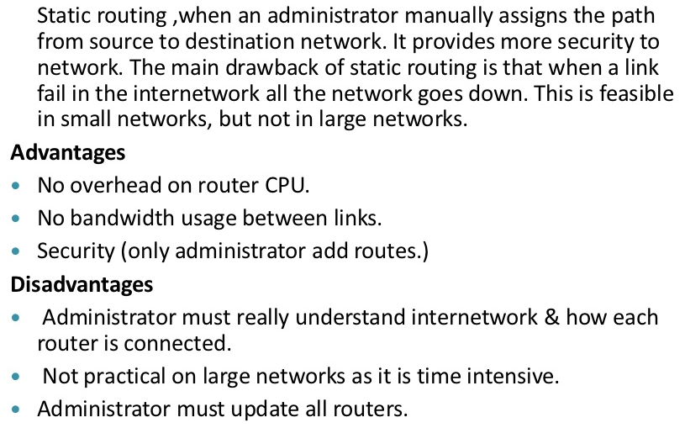
Static Routing Protocols

Slide 11
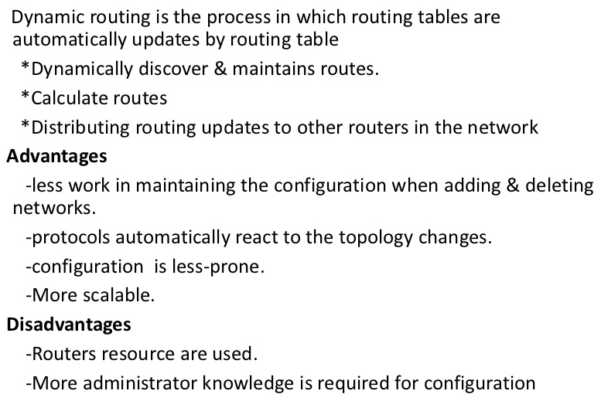
Dynamic Routing Protocols

Slide 12
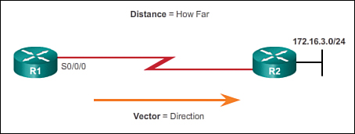
Distance Vector Routing Protocols
Distance vector means that routes are advertised by providing two characteristics:
Distance: Identifies how far it is to the destination network and is based on a metric such as the hop count, cost, bandwidth, delay, and more
Vector: Specifies the direction of the next-hop router or exit interface to reach the destination

Slide 13
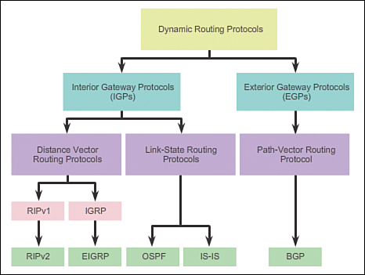

Slide 14
Distance Vector Routing or Bellman Ford Algorithm is a type of algorithm used by routing protocols to learn routes on an interconnected network. Routing protocols that use distance-vector routing protocols include:
1. Routing Information Protocol RIP.
2. Cisco's Internet Gateway Routing Protocol IGRP.
3. Apple's Routing Table Maintenance Protocol RTMP.
In distance vector routing when a router is booted it maintains a routing table advertising vector of distance and direction. Direction is represented by next hop address, whereas Distance uses metrics such as hop count.
After every fixed period of time router exchanges its routing table with its neighbouring router and we get a new merged table.

Slide 15
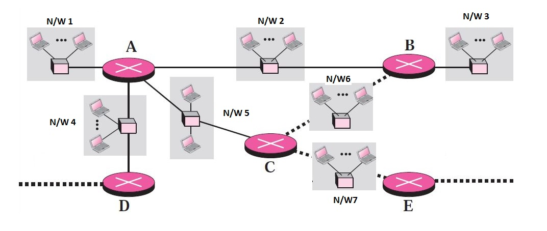
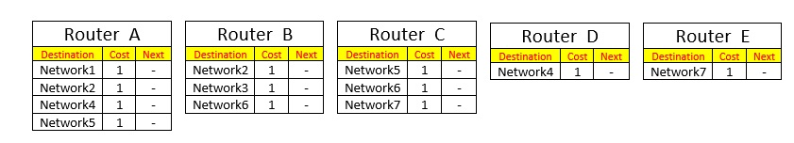
When Routers are booted Routers gathers information from attached networks and maintains following routing tables:

Slide 16
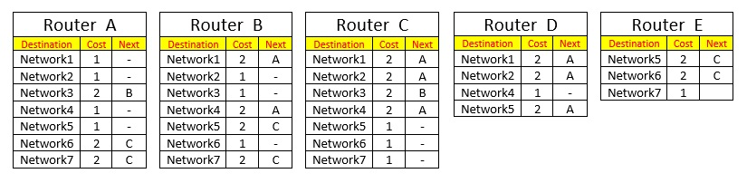
After a fixed period of time routing tables of the neighbouring tables are shared:
Router A swaps its information with Router B , Router C and Router D.
Router B swaps its information with Router A and Router C
Router C swaps its information with Router A, Router B and Router E
Router D swaps its information with Router A
Router E swaps its information with Router C

Slide 17
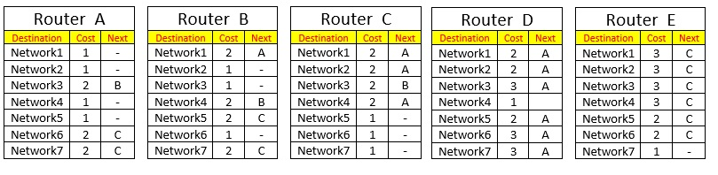
After a fixed period of time updated routing tables of the neighbouring tables are shared:
Router A swaps its information with Router B , Router C and Router D.
Router B swaps its information with Router A and Router C
Router C swaps its information with Router A, Router B and Router E
Router D swaps its information with Router A
Router E swaps its information with Router C
Note: See example of Bellman Ford Algorithm.

Slide 18
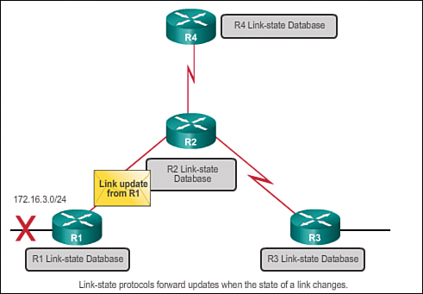
Link-State Routing Protocols
Router configured with a link-state routing protocol can create a complete view or topology of the network.
This is done by gathering information from all of the other routers.
Link-state update is only sent when there is a change in the topology

Slide 19
Link-state protocols work best in situations where:
The network design is hierarchical, usually occurring in large networks.
Fast convergence of the network is crucial.
The administrators have good knowledge of the implemented link-state routing protocol
There are two link-state IPv4 IGPs:
OSPF: Popular standards-based routing protocol
IS-IS: Popular in provider networks

Slide 20
Open Shortest Path First (OSPF)
Open Shortest Path First (OSPF) is another Interior Gateway Protocol. OSPF was created because the Routing Information Protocol (RIP) was increasingly incapable of serving large inter-networks.
OSPF is based on the Shortest Path First algorithm, which is also referred to as the Dijkstra’s algorithm.
OSPF is a link-state routing protocol as it sends state of all other routers.
This protocol is open, which means anyone can implement it without paying license fees.
It supports both IPv4 and IPv6 routed protocols.
There are certain disadvantages of OSPF also, it requires extra CPU process to run SPF algorithm, it requires more RAM and is more complex to setup and hard to troubleshoot.

Slide 21
Link State of can be measured using following metrics:
Measuring link utilization
Number of hops (hop count)
Speed of the path
Packet loss (router congestion/conditions)
Latency (delay)
Path reliability
Path bandwidth
Throughput
Load on link
MTU maximum transmission unit

